Slide 1
Chapter 11: Quick Overview
Three Chinese Dynasties: Sui, Tang, and Song
Buddhism spread throughout China during the Tang Dynasty and, when that dynasty fell, its leaders blamed their problems on Buddhism
During the Song years there were many great inventions including gunpowder and movable type

Slide 2
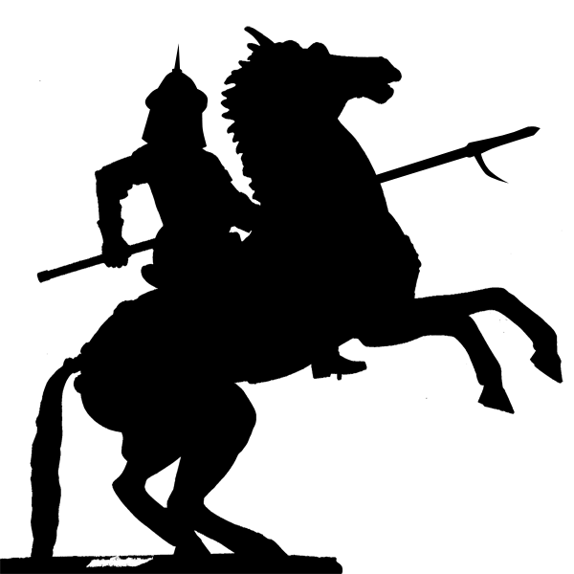
The Rise of the Mongols

Slide 3
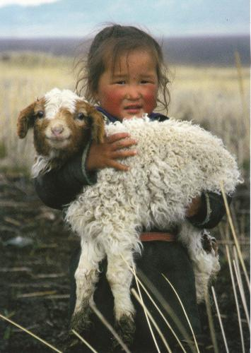
Nomadism in Central and Inner Asia
The Mongols were traditionally a nomadic people, always on the move with their animal herds
The Mongols put their infants on goats in order to accustom them to life in the saddle
Khan – The leader of a Mongol clan

Slide 4
Nomadism in Central and Inner Asia
“Please don’t ride me…”

Slide 5
Nomadism in Central and Inner Asia
Slaves performed menial work, allowing for the Mongol men to spend more time waging wars
Continuity with Sparta?
The most powerful Mongol families lived almost entirely off of tribute from other groups
Arranged marriages allowed for powerful families to join together

Slide 6
Nomadism in Central and Inner Asia
Most Mongols believed in traditional shamanism, which involved special priests or shaman to communicate with the supernatural world
However, families often included believers of more than one religion
This includes Buddhism, Christianity, and Islam

Slide 7
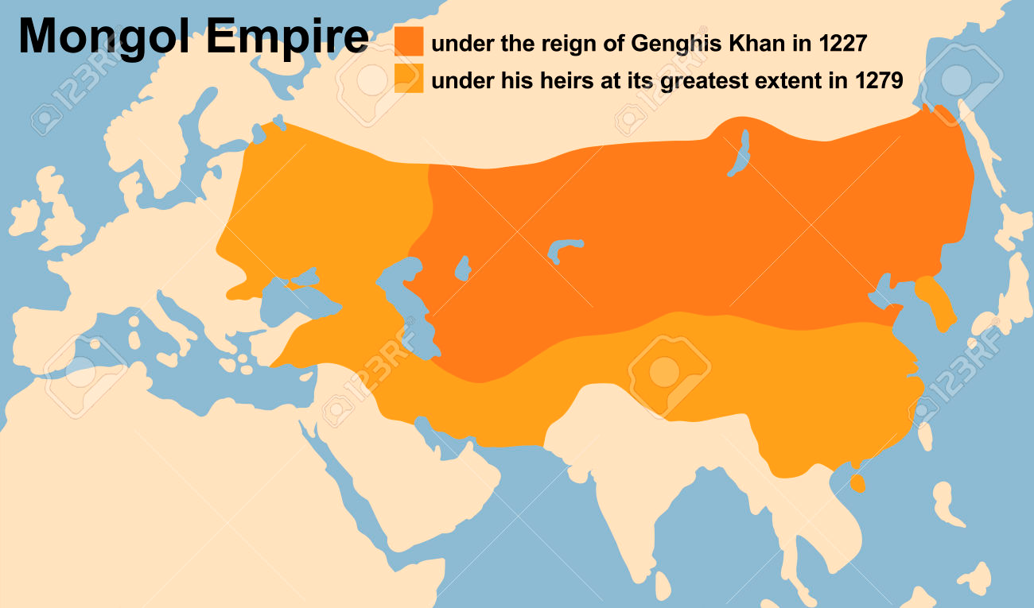
The Mongol Conquests
Genghis Khan = Chinggis Khan
Conquered a LOT of territory

Slide 8
The Mongol Conquests
Ogodei, Genghis Khan’s son, became the great Khan after his death and expanded Mongol territory into China and Russia
When Ogodei died, all of the Mongol armies had to return to their capital city of Karakorum in Mongolia to elect a new Khan
This allowed central and western Europe to escape invasion

Slide 9
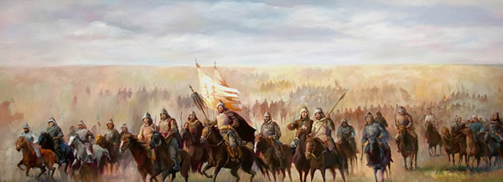
The Mongol Conquests
Mongol armies were often outnumbered but relied on superior horsemanship (and horsewomanship?) and their “Mongol bow”, which shot further than other bows of the time

Slide 10
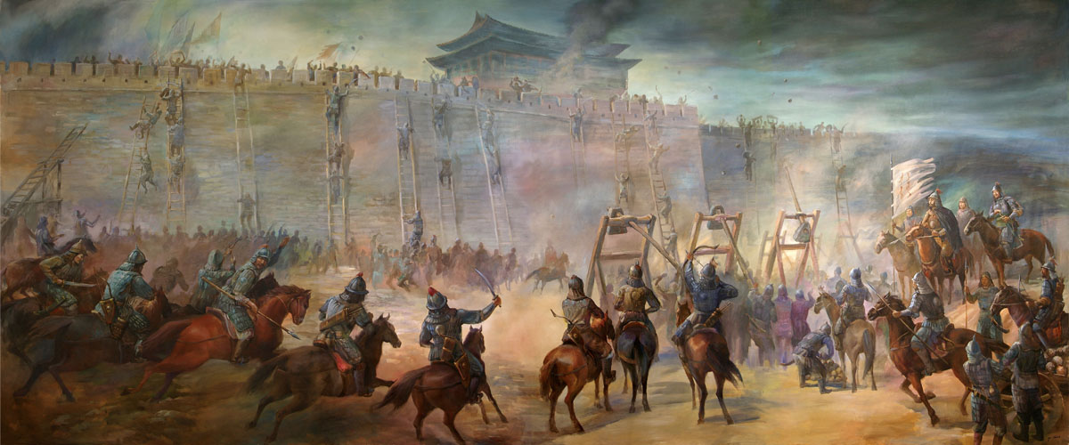
The Mongol Conquests
The Mongols destroyed cities and slaughtered people without remorse so that other cities would surrender before the Mongols even arrived

Slide 11
Overland Trade and Disease
Silk, art, and other luxury goods flowed from China towards the Middle East and Europe
Merchants encountered ambassadors, scholars, and missionaries over long routes to Mongol courts
Marco Polo: Venetian (from Venice, in Italy) traveller who visited the court of Kublai Khan, the Mongol king in China, and reported back fantastical stories to Europeans

Slide 12
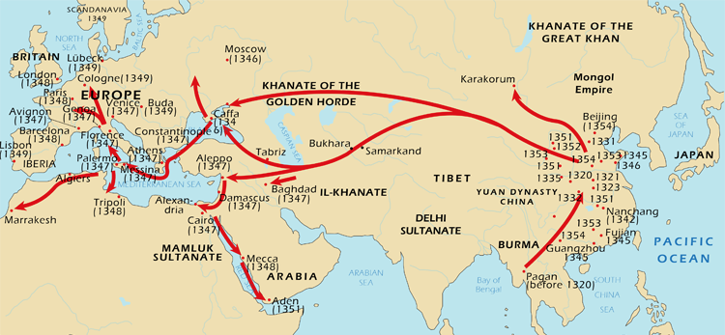
Overland Trade and Disease
The Mongols helped spread the bubonic plague across Asia and eventually into Europe
Jerks
The plague spread through flea infested rats

Slide 13
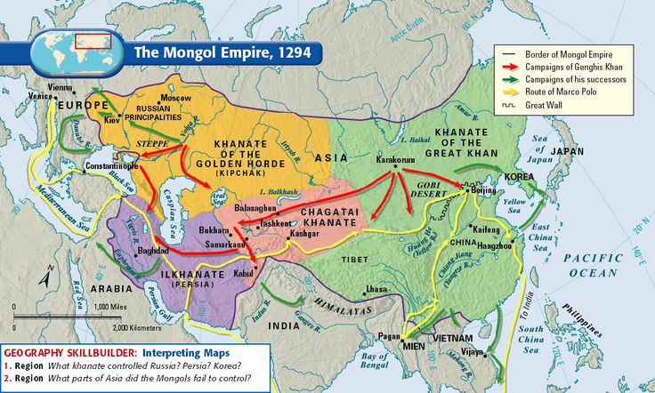
Four Khanates

Slide 14
History vs. Genghis Khan

