Slide 1
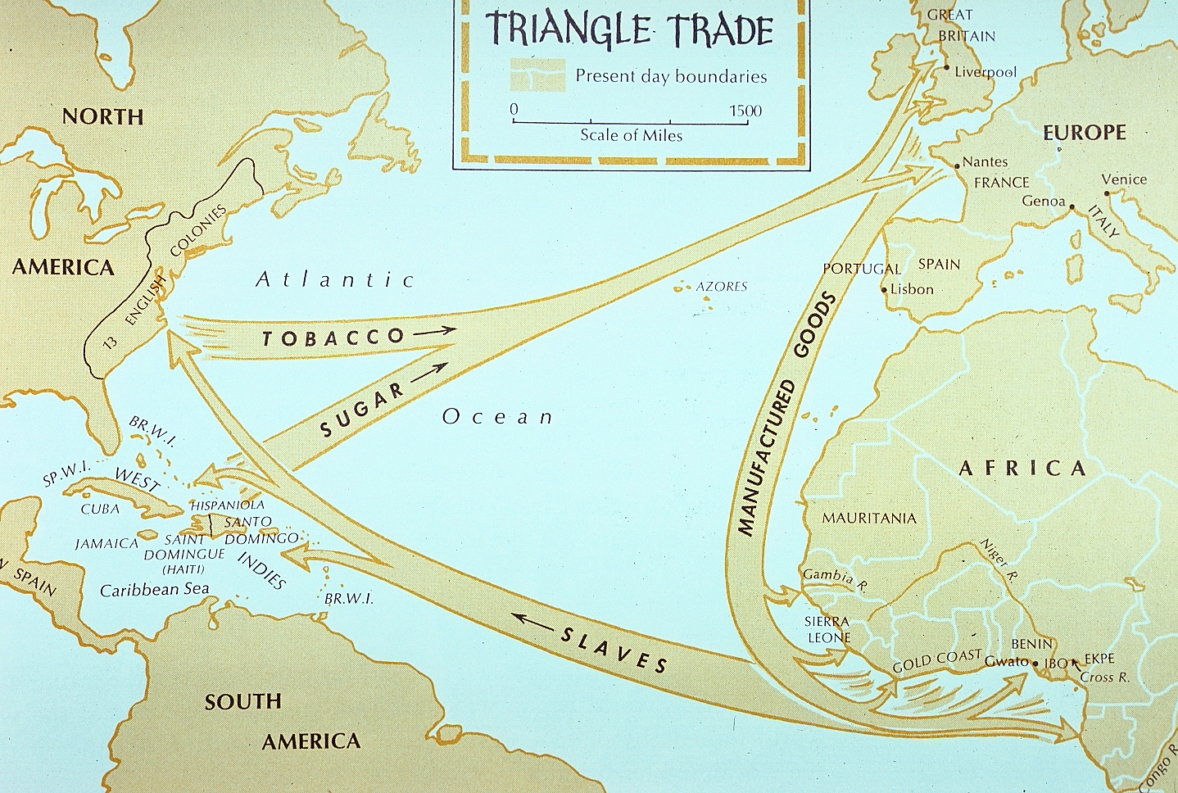
Sugar Trade DBQ
Sugar Trade DBQ
Wednesday, December 2nd

Slide 2
Sugar Trade Timeline

Slide 3
1493: Columbus introduces cane sugar to West Indies
Columbus to the Caribbean
Crossed the Atlantic Ocean
Originally looking for ocean path to India
Plants sugar, grows well in “West Indies”

Slide 4
1509: First African slaves already in Santo Domingo
Santo Domingo = Dominican Republic
Why bring African slaves?
Native Americans are dying: disease, worked to death
Were Africans brought of their own free will?

Slide 5
1509: First African slaves already in Santo Domingo
Africans selling other Africans for guns/other goods
Tons and tons of silver in the New World, where does it end up? China!
Europeans love buying things from China but China wants nothing from them. But they do accept silver…
Spanish American Colonial Hierarchy
Peninsulares
Creoles
Mestizos, Mulattos
Native Americans, African Slaves

Slide 6
c. 1625: Portuguese supplying nearly all of Europe’s sugar cane from Brazil
Desire for sugar grows, first coffee house
Sugar is an auxiliary: don’t eat it by itself
Needs to be in cake, chocolate, cake, tea, etc.

Slide 7
c. 1632: First coffee house opens in England
British capture Jamaica to compete with Portuguese Brazil
Sugar is big business, need more land and more slaves!

Slide 8
c. 1655: First coffee house opens in England
Mercantilism = competition!
European powers want more land and more money
Spain, Portugal, English, French in the New World

Slide 9
c. 1740: France becomes biggest sugar trader
By this point, Spain and Portugal are falling behind England and France due to economic collapse
Eventually, the silver begins to run out

Slide 10
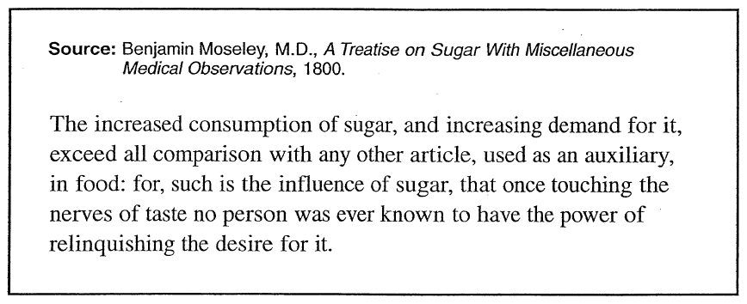
Document C
What is the author’s POV?
Who is the intended audience?
What is the purpose of this document?
What is the historical context of this document?

Slide 11
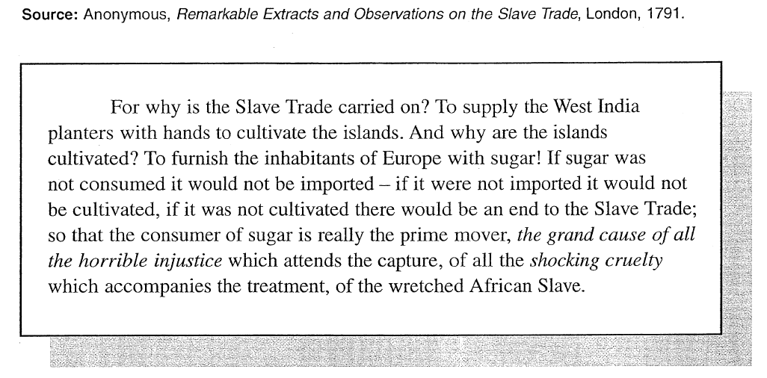
Document D
What is the author’s POV?
Who is the intended audience?
What is the purpose of this document?
What is the historical context of this document?

Slide 12
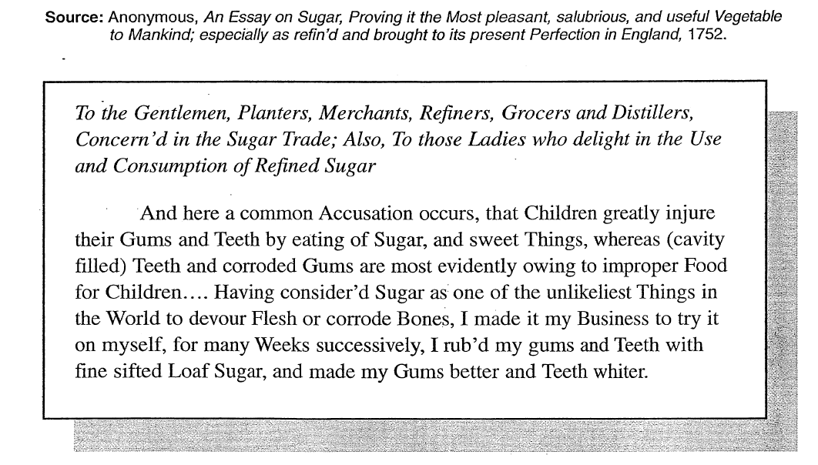
Document E
What is the author’s POV?
Who is the intended audience?
What is the purpose of this document?
What is the historical context of this document?

Slide 13
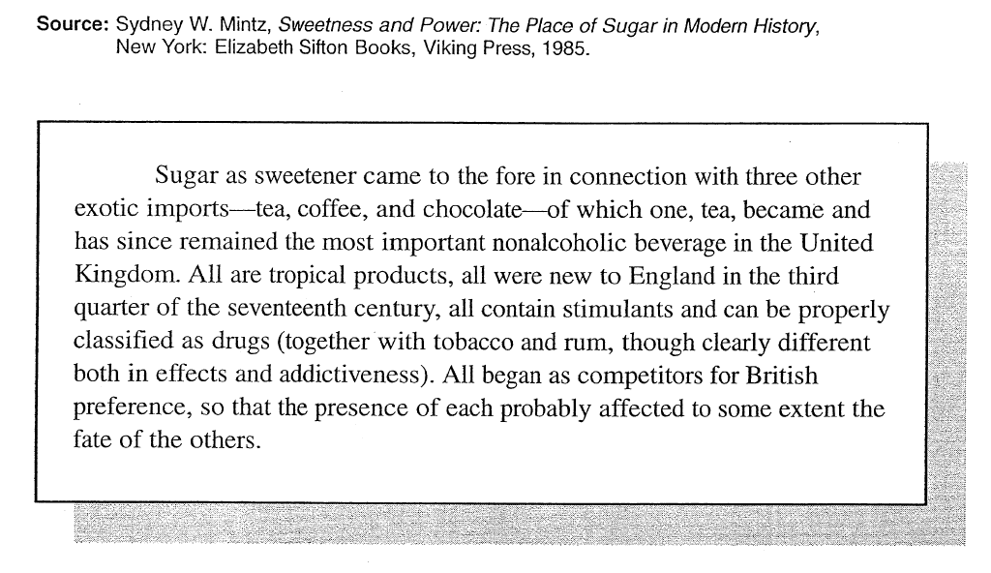
Document F
What is the author’s POV?
Who is the intended audience?
What is the purpose of this document?
What is the historical context of this document?

Slide 14
Document: de las Casas
On your own, read the document and answer the following questions before we share
Knowing who the author is, what do you think his motivation was for writing this document?
Who do you think the audience is for this document? Do you think they would take the document seriously? Why or why not?
Would you consider this document to be convincing? Why or why not?

