Slide 1
LEQ Question Types
Comparison (Comparing two regions, ideas, religions, etc.)
Causation (Cause and Effect over a span of time, Cause and Effect of important historical processes or patterns)
Continuity and Change Over Time (BOTH what stays the same and what changes over a time span)
Periodization (How something is a turning point, or evaluation of a characteristic of an era)

Slide 2
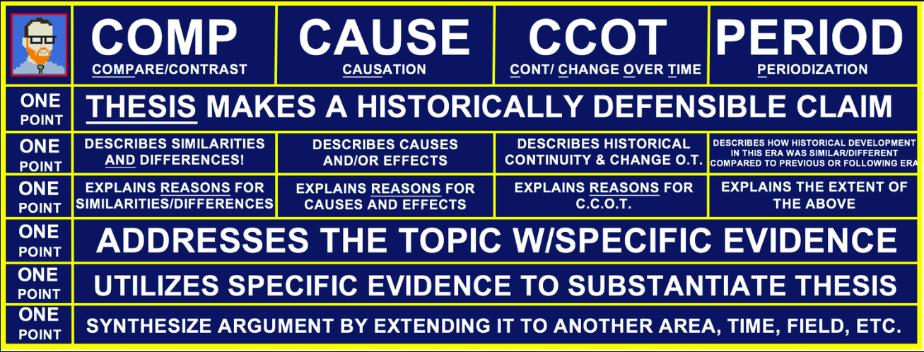
LEQ Question Types

Slide 3
LEQ Question Types
COMPARISON:
1 Point-Describes similarities AND differences
1 Point-Explains the reasons for similarities AND differences

Slide 4
LEQ Question Types
Example:
Using your knowledge of world history, compare the spread of Buddhism with the spread of Christianity.

Slide 5
LEQ Question Types
CAUSATION:
1 Point-Describes cause AND/OR effects
1 Point-Explains the reasons for the causes AND/OR effects
Scoring Note: If the prompt requires discussion of both cause and effects, responses must address both causes and effects in order to earn both points.

Slide 6
LEQ Question Types
Example:
Go to Albert, click on classes, AP World History, and Free Response
Global Migration

Slide 9
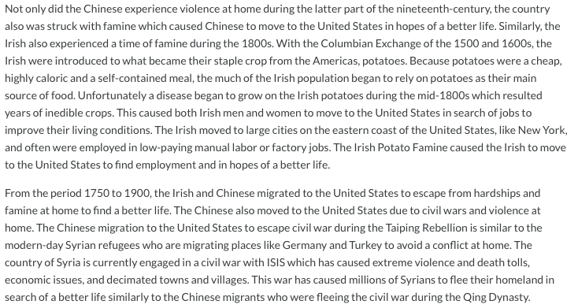

Slide 10
LEQ Question Types
CONTUNITY AND CHANGE OVER TIME
1 Point-Describes historical continuity AND change over time.
1 Point-Explains the reasons for historical continuity AND change over time

Slide 11
LEQ Question Types
PERIODIZATION:
1 Point-Describes the ways in which the historical development specified in the prompt was different fro and similar to developments that preceded AND/OR followed.
1 Point Explains the extent to which the historical development specified in the prompt was different from and similar to developments that precede AND/OR followed.
Scoring Note: For both points, if the prompt requires evaluation of a turning point, then responses must discuss developments the preceded AND followed.

Slide 12
LEQ Question Types
Example:
Go to Albert, click on classes, AP World History, and Free Response
European Age of Exploration

Slide 15
