Slide 1
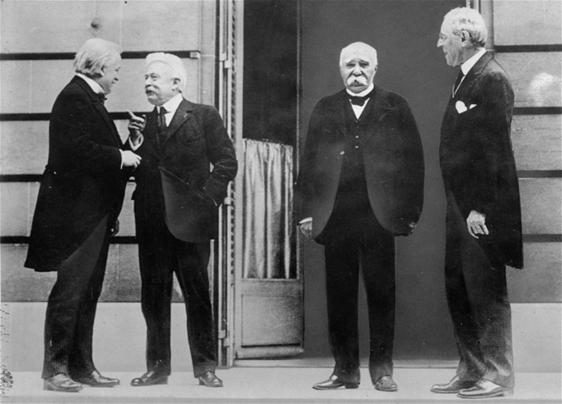
Chapter 27: The Crisis of the Imperial Order, 1900-1929
Peace and Dislocation in Europe

Slide 2
Chapter 27: The Crisis of the Imperial Order, 1900-1929
Country | Lives lost
Germany | 2,000,000
Russia | 1,700,000
France | 1,700,000
Austria-Hungary | 1,500,000
British Empire | 1,000,000
Italy | 460,000
United States | 115,000

Slide 3
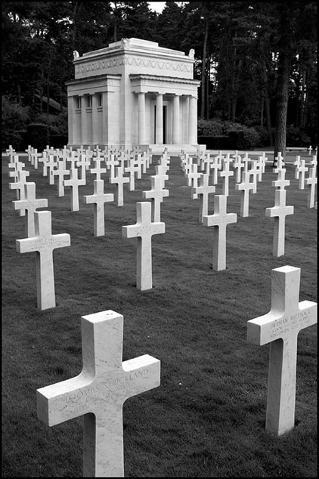
Chapter 27: The Crisis of the Imperial Order, 1900-1929
The Impact of the War
It is estimated that between 8 and 10 million people died during the war
Around twice as many returned home wounded or shell-shocked
The war also dislocated whole populations, creating millions of refugees
Most of these refugees ended up in France or the United States

Slide 4
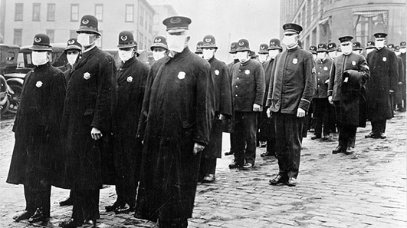
Chapter 27: The Crisis of the Imperial Order, 1900-1929
One unexpected byproduct of the war was the great influenza epidemic of 1918-1919
This strain of the flu virus started among soldiers heading for the Western Front
It infected almost everyone on earth and killed one in every forty people
30 million died around the world, 20 million in India alone

Slide 5
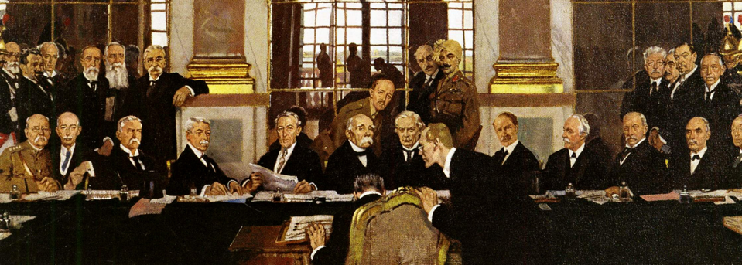
Chapter 27: The Crisis of the Imperial Order, 1900-1929
The Peace Treaties
In early 1919, the victorious powers met in Paris
The defeated powers were kept out until the treaties were ready for signing
Russia, in the middle of a civil war, was not invited

Slide 6
Chapter 27: The Crisis of the Imperial Order, 1900-1929
Three men dominated the Paris Peace Conference: U.S. President Woodrow Wilson, British Prime Minister David Lloyd George, and French Premiere Georges Clemenceau
They ignored the Italians, who joined the allies in 1915
They paid even less attention to the smaller nations of Europe and paid no attention to any non-European nations
They rejected the Japanese proposal that all races be treated equally
They ignored the Pan-African Congress created to call attention to the concerns of African people around the world
“Three all-powerful, all-ignorant men, sitting there carving up continents”.

Slide 7
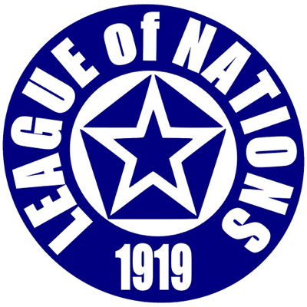
Chapter 27: The Crisis of the Imperial Order, 1900-1929
Woodrow Wilson was an idealist who wanted to apply the principles of self-determination to European affairs, by which he meant creating nations that reflected ethnic or linguistic divisions
He proposed a League of Nations, a world organization to safeguard the peace and foster international cooperation

Slide 8
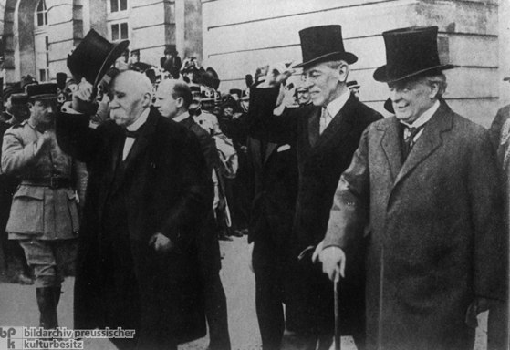
Chapter 27: The Crisis of the Imperial Order, 1900-1929
The European leaders were more concerned with what was best for their nations
Lloyd George insisted that Germany pay a heavy war indemnity
Clemenceau demanded that Germany return the provinces of Alsace and Lorraine
He also wanted the Rhineland to be detached from Germany to form a buffer state

Slide 9
Chapter 27: The Crisis of the Imperial Order, 1900-1929
The result was a series of compromises that satisfied no one
The U.S. Congress refused to join the League of Nations, reflecting the isolationist beliefs of many of its citizens
France received Alsace and Lorraine but the Rhineland remained a part of Germany
Britain received territories in Africa and the Middle East but was greatly weakened by the loss of human life and the disruption of their trade

Slide 10
Chapter 27: The Crisis of the Imperial Order, 1900-1929
On June 28th, 1919, the German delegates reluctantly signed the Treaty of Versailles
Germany was forbidden from having an air force and was permitted only a small army/navy
It gave up large parts of its eastern territory to the newly reformed nation of Poland
The Allies forced Germany to pay reparations but they did not set a figure or a time period for payment
A “guilt clause” obliged the Germans to accept “responsibility for causing all the loss and damage” of the war
The treaty left Germany humiliated but still largely intact and potentially still the most powerful nation in Europe
Establishing a peace neither of punishment nor of reconciliation, the treaty was one of the greatest failures in history

Slide 11
Chapter 27: The Crisis of the Imperial Order, 1900-1929
Meanwhile, the Austro-Hungarian Empire had fallen apart
Each nation lost ¾ of their lands creating a new Polish state as well as Czechoslovakia and Yugoslavia
These new boundaries coincided with major linguistic groups but still contained dissatisfied minorities

Slide 12
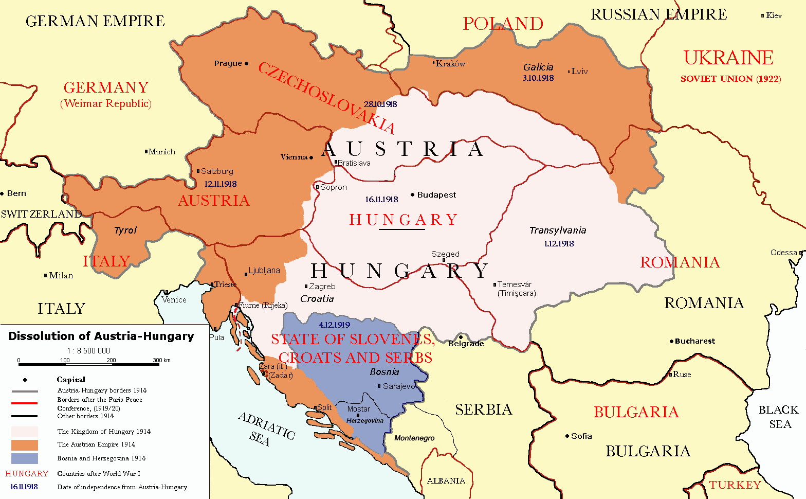
Chapter 27: The Crisis of the Imperial Order, 1900-1929

Slide 13
Chapter 27: The Crisis of the Imperial Order, 1900-1929
Russian Civil War and the New Economic Policy
In December 1918, civil war broke out in Russia
The Communists, as the Bolsheviks began calling themselves, held central Russia but all of the surrounding provinces rose up against them
These counterrevolutionary armies were led by former tsarist officers, often supplied by the Allies (France, Britain, USA)
Three million died during the seven year struggle
The eventual Communist victory was largely due to the discipline of the “Red Army” and genius of their commander, Leon Trotsky

Slide 14
Chapter 27: The Crisis of the Imperial Order, 1900-1929
The Red Army was able to re-conquer much of the territory lost during the end of the czar’s reign
In December of 1920, Ukrainian Communists declared the independence of a Soviet Republic of Ukraine
They then merged with Russia in 1922 to create the Union of Soviet Socialist Republics (USSR)
The Bolsheviks were opposed to colonization but were able to retain control over Soviet “satellite states” in Georgia, Armenia, and Azerbaijan (Central Asia)

Slide 15
Chapter 27: The Crisis of the Imperial Order, 1900-1929
After years of civil war, the country’s economy was in ruins
Vladimir Lenin sought to correct this by releasing the economy from government control
The New Economic Policy allowed peasants to own land and sell crops, private merchants to trade, and private workshops to produce goods and sell them on the free market
This plan was immediately successful an helped relieve much of the nations problems
However, it did not change the long-term goals of the Communist government, which involved the end of private property and government control of all aspects of the economy
“One step backwards, two steps forward” – Lenin

Slide 16
Chapter 27: The Crisis of the Imperial Order, 1900-1929
When Lenin died in 1924, his associates fought for power
The leading contenders were Leon Trotsky, commander of the Red Army, and Joseph Stalin, general secretary of the Communist party
Trotsky wanted to spread Communism around the world, Stalin believed it would only be successful in one country
Stalin filled the party administration with individuals loyal to himself and accused Trotsky of “deviation of the party line”, forcing him to flee the country (poor Snowball…)

