Slide 1
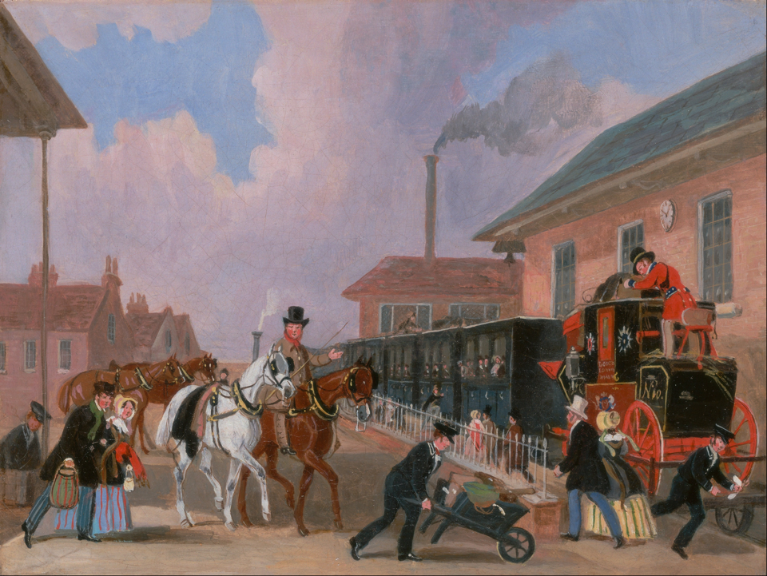
Chapter 26 The New Power Balance

Slide 2
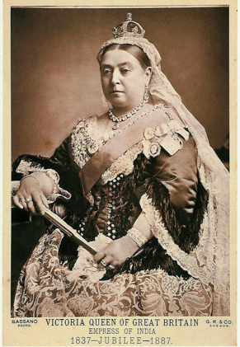
Victorian Age and Women’s “Separate Sphere”
In English-speaking countries, the period from 1850 to 1914 is known as the Victorian Age
This expression refers to not only the reign of Queen Victoria of England but to rules of behavior and to an ideology surrounding the family and relations between men and women
Victorians emphasized differences in race, socio-economic level, and gender

Slide 3
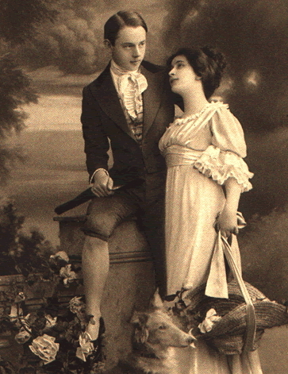
Victorian Age and Women’s “Separate Sphere”
They stressed the romantic aspects of both love and marriage as well as duty to family/religion
They contrasted the masculine ideals of strength and courage with the feminine ideals of beauty and kindness
The home was seen as a safe refuge from the dog-eat-dog world of competitive capitalism

Slide 4
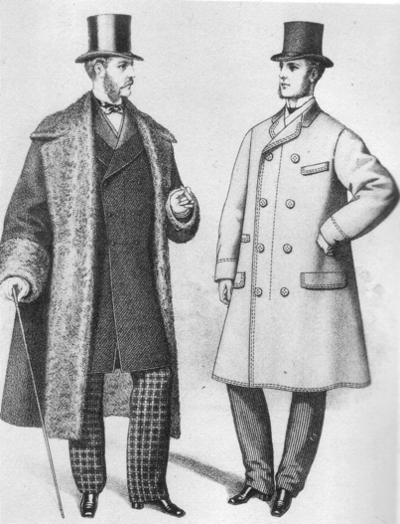
Victorian Age and Women’s “Separate Sphere”
Men and women were put in “separate spheres”
Men went to work and spent time at men’s clubs
Women were in charge of rearing the children , running the household, and spending the family money to enhance the family’s social status

Slide 5
Victorian Age and Women’s “Separate Sphere”
Plumbing, central heating, and gas/electricity gradually helped middle class families
The most important duty of middle-class women was the raising of children
Unlike women from previous eras who had other people raise their children, Victorian mothers were personally involved in the process
Boys were groomed for business and girls were trained in tasks that offered no monetary reward or professional preparation

Slide 6
Victorian Age and Women’s “Separate Sphere”
Women were considered “minors for life” in most European countries, meaning that they were subject to their fathers or husbands
Jobs that required higher education were closed to women
Until late in the 19th century few universities granted degrees to women

Slide 7
Victorian Age and Women’s “Separate Sphere”
The first profession to open up to women was teaching as more and more countries passed laws calling for universal compulsory education
However, this only applied to single women, as married women were expected to get pregnant as soon as they were married
Some women began to organize to fight against prostitution, alcohol, and labor

Slide 8
Labor Movements and Socialist Politics
Socialism was an ideology developed by radical thinkers who questioned the sanctity of private property and argued in support of industrial workers against their employers

Slide 9
Labor Movements and Socialist Politics
Labor Unions were organizations formed by industrial workers to defend their interests in negotiations with employers
Labor unions fought not only for better wages but also improved working conditions and insurance against illness, accidents, disability, and old age

Slide 10
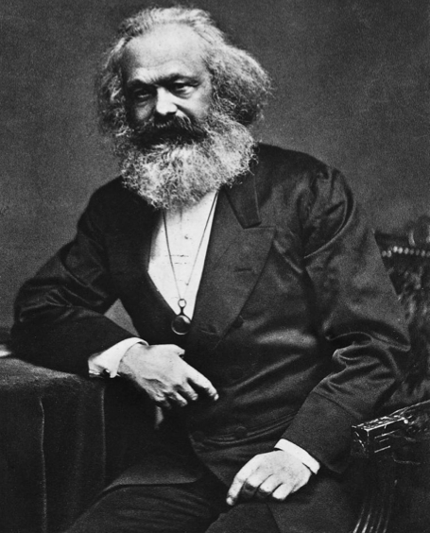
Labor Movements and Socialist Politics
Karl Marx was a German journalist and writer who was influenced by German philosophy, French revolutionary ideas, and his knowledge of the British industrial conditions

Slide 11
Labor Movements and Socialist Politics
He wrote two books, the Communist Manifesto and Das Kapital
Marx argued that the capitalist system allowed the bourgeoisie (the owners of businesses and factories) to extract the surplus value of worker’s labor
Surplus value – The difference between workers wages and the value of the goods they created

Slide 12
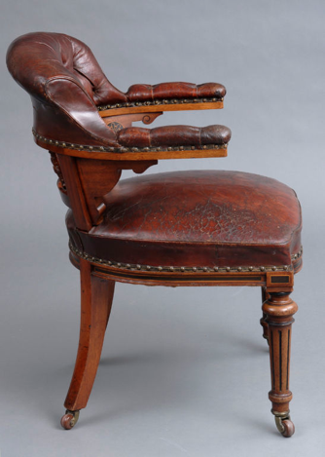
MATH! NOOOOOOOOOOO!
A business makes chairs
Each chair costs $15 dollars to construct
$3 to pay for workers wages
$12 for parts and factory costs
The chair is sold for $45 dollars
The profit is $30, where does this money go?

Slide 13
Labor Movements and Socialist Politics
As universal male suffrage spread throughout the U.S. and Europe, Socialist political parties grew more powerful because the working class now had the right to vote
One example is the Social Democratic Party of Germany, which gained popularity in the late 19th and early 20th centuries
Working class women were not able to participate in these new political processes

Slide 14
Working-Class Women and Men
Working-class women faced many obstacles in their lives during this time
Parents expected girls as young as ten to contribute to the household
Many girls becoming domestic servants and worked around 16 hours a day for 6 ½ days a week
Female servants were vulnerable to sexual abuse by their masters or their masters’ sons

Slide 15
Working-Class Women and Men
Many women preferred working in a factory to domestic life
Women typically worked in textiles (fabrics) and clothing trades
New laws meant that women were not allowed to work in many of the most dangerous factories or industrial positions for safety reasons, but this also limited their earning ability

Slide 16
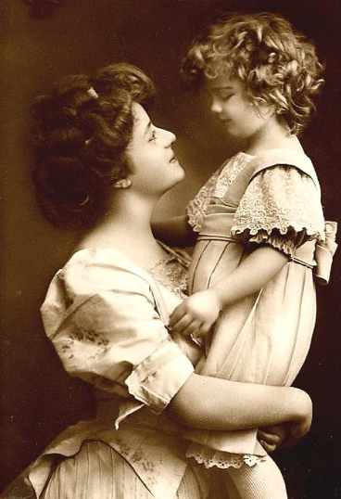
Working-Class Women and Men
Married women with children were expected to stay at home regardless of their husbands income
These women were still expected to contribute and often sewed items to be sold or washed other people’s clothes

Slide 17
Italian and German Unification
Language and National Identity Before 1871
Nationalism: A political ideology that stresses people’s membership in nation – a community defined by a common culture and history as well as territory
Language was usually the crucial element in a feeling of national unity
The idea of redrawing boundaries to fit linguistic, religious, or cultural differences was revolutionary

Slide 18
Italian and German Unification
Liberalism: The middle-class ideology that asserted the sovereignty of people and demanded a constitutional government, a national parliament, and freedom of expression

Slide 19
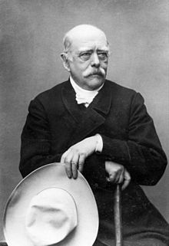
Italian and German Unification
The Unification of Germany
Otto Von Bismarck: The chancellor of Prussia who is responsible for the creation of the German Empire in 1871, after military victories over Denmark, Austria, and France

Slide 20
Italian and German Unification
Nationalism After 1871
Politicians began to manipulate public opinion to help their governments
Governments realized the advantaged of having an educated population and began opening schools in every town and city
The spread of literacy allowed politicians and journalists to appeal to the emotions of the poor, diverting their anger from their employers to foreigners and their votes from socialist to nationalist political parties
Western culture in the late 19th century exalted the powerful over the weak, men over women, rich over poor, Europeans over other races, and humans over nature
This led to the concept of Social Darwinism, where people applied Charles Darwin’s theory of “survival of the fittest” to humanity, arguing that certain people are biologically superior to others and meant to be more successful

