Slide 1
2.4 Ancient Rome

Slide 2
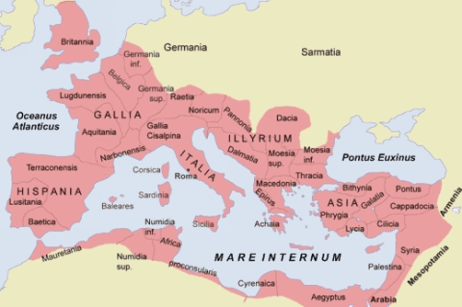
Creation of a Mediterranean Empire
Location makes it ideal for Mediterranean conquest

Slide 3
A Republic of Farmers
Land became basis for wealth
The Senate: Council of Elders, important in Roman politics
Roman Republic: Not a democracy, rich votes count for more
Consuls: Two heads of state at once
Senate: Wealthy, influential people, sometimes from military

Slide 4
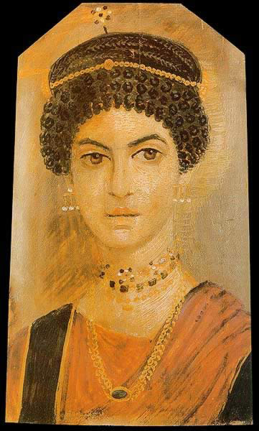
A Republic of Farmers
Patron/Client Relationship: Successful man teaching younger apprentice
Roman women had no public role but still more agency than Greek women

Slide 5
Expansion in Italy and the Mediterranean
Romans were always seeking to expand
Rome first conquered all of Italian peninsula
Conquered peoples became citizens (unlike Greece) which helped Rome grow and succeed

Slide 6
The Failure of the Republic
Small farmers left for war, farms taken over by large estates (latifundias)
Peasants wanted change after losing land, being replaced by slaves

Slide 7
The Failure of the Republic
Armies are now loyal to generals, not republic
Octavian/Augustus takes power as “emperor”
Succession: Adopted son takes over (qualified)

Slide 8
An Urban Empire
Not everyone lived in cities but the empire was administered through a network of towns and cities
Pax Romana: Roman Peace, safe and efficient to trade over long distances
Romanization: Spread of Latin language and Roman way of life

Slide 9
The Rise of Christianity
Jesus killed by Roman governor, Pontius Pilate
Paul spreads religion, uses great Roman roads
Persecuted by Roman officials for not honoring Roman empire/emperor
Slowly becomes a sizeable minority by the third century CE

Slide 10
Technology and Transformation
Roman engineering was the best the world had seen
Aqueducts: Carried water from its source to an urban center

Slide 11
Technology and Transformation
After Augustus, expansion slows
More land = more problems
Constantine becomes emperor and reunited Rome in 324
Wins a battle, sees a cross in the sky
Makes Christianity official Roman religion (changes Europe forever)
Capital moves to Constantinople (Byzantium)

