Slide 1
Warm-Up: Please have your reading notes out on your desk and answer the question below. I will be coming around to check your notes
Are you #TeamAthens or #TeamSparta? Come up with three reasons why you made the choice that you did and write your name on the board. Be prepared to share your reasoning.

Slide 2
Rise of the Greeks
Monday, September 12th

Slide 3
Agenda
Warm-Up/Notes Check
Overview of Reading
Primary Sources: “Death of Socrates” and “The Allegory of the Cave”
Video: 300 Clip
Athens/Sparta: Reading and Comparison

Slide 4
Geography and Resources
Easy to migrate around Greece
Aegean Sea connected Greeks across the water in Ionia
Relied on rainfall for crops
Forced to travel by sea to find resources

Slide 5
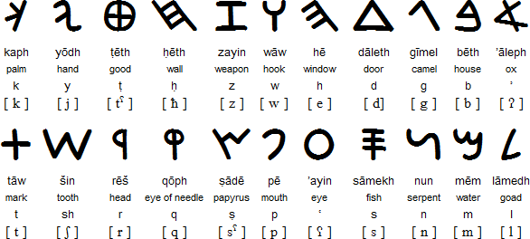
The Emergence of the Polis
Phoenicians bring alphabet (22 symbols)
Made writing more accessible to common people

Slide 6
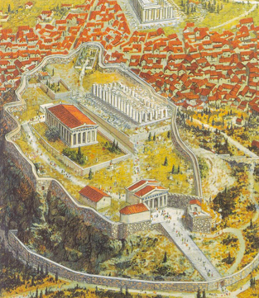
The Emergence of the Polis
Polis: City-state, includes city center and rural farms
Acropolis: The top of the city

Slide 7
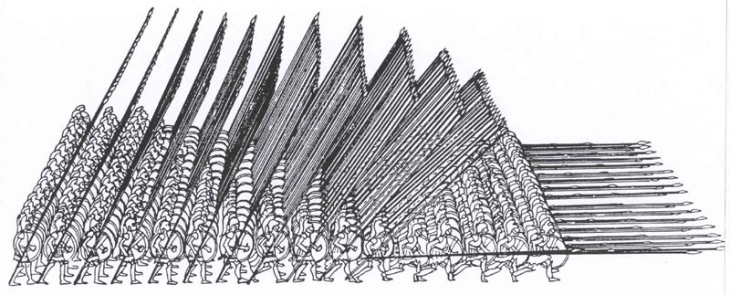
The Emergence of the Polis
Hoplite: Heavily armored soldier, circular shield and long spear
Formation called a Phalanx

Slide 8
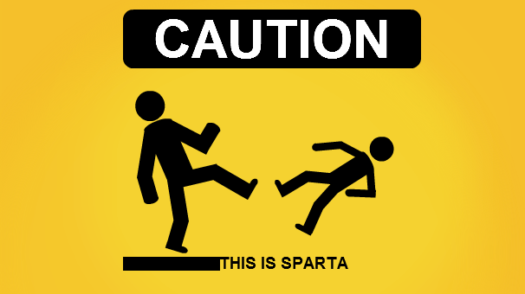
The Emergence of the Polis
Farmers as soldiers: no special training
Exception: Sparta

Slide 9
New Intellectual Currents
Importance of “individualism”
Individuals are important, not just a part of a collective
Humanism: Be you! Uniqueness is valuable

Slide 10
New Intellectual Currents
Sparta
Helots: enslaved, conquered people
Weak children left to die
Children taken at young age for training
Superior army: all professional soldiers
“Arrogance, ignorance, cruelty”
Women had a larger role in society

Slide 11
New Intellectual Currents
Athens
Democracy: Adult, free, males
Pericles helped create Athenian democracy
Concentrated on trade, art, plays, philosophy
Women were expected to remain in the home
Not as concerned with military

Slide 12
Athenian Philosophy: The Death of Socrates

Slide 13
Athenian Philosophy: Allegory of the Cave

Slide 14
Spartan Warfare: 300

Slide 15
Ancient Greece: Wife Swap

Slide 16
Athens/Sparta

Slide 17
Homework
Read pages 121-133 (Struggle/Synthesis)

