Slide 1
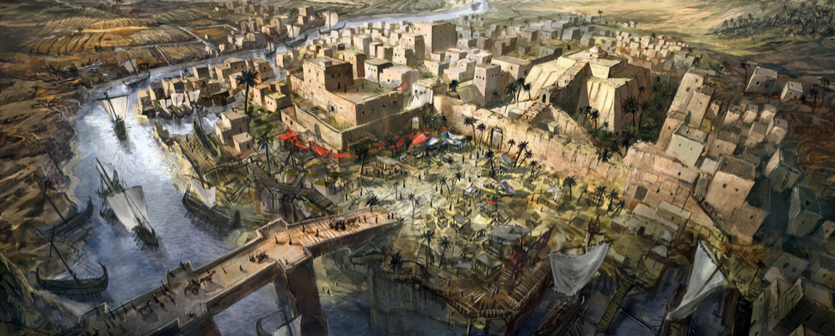
1.2 Mesopotamia
Pgs. 15-23

Slide 2
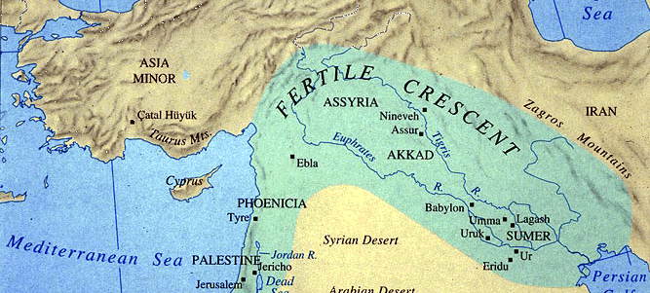
Introduction
Mesopotamia – “Land Between Two Rivers”
Tigris and Euphrates Rivers
Especially fertile thanks to the build up of silt deposited from the rivers over thousands of years

Slide 3
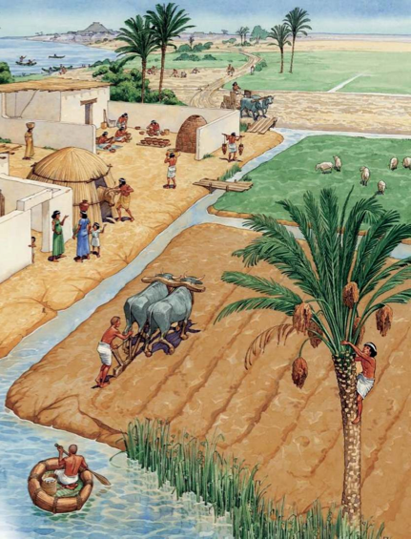
Settled Agriculture in an Unstable Landscape
During this time, people learned to construct canals & use irrigation in order to grow their crops
Irrigation: To supply land with water using artificial means

Slide 4
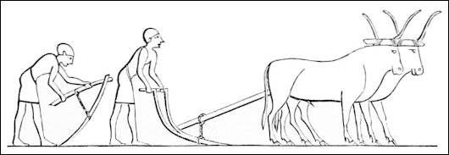
Settled Agriculture in an Unstable Landscape
By 4000 BCE farmers used ox-drawn plows to plant their crops
Fields were left fallow (unused) every other year in order to allow nutrients to return to the soil

Slide 5
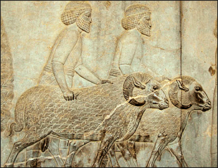
Settled Agriculture in an Unstable Landscape
Fish were a dietary staple
Sheep and goats provided provided wool, milk, and meat
Donkeys and cattle were used as beasts of burden

Slide 6
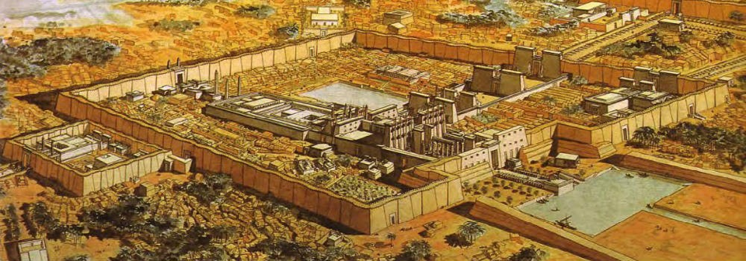
Cities, Kings, and Trade
Villages grew together to form large cities that provided protection and more labor for farming
City-State: A small independent state consisting of an urban center and the surrounding agricultural territory

Slide 7
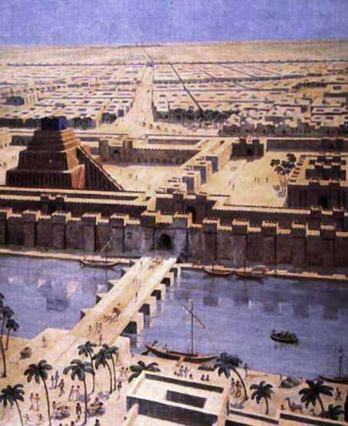
Cities, Kings, and Trade
Specialized labor in Mesopotamia included craft making, manufacturing pottery, artwork, clothing, weapons, and tools
Protective walls were built to keep citizens safe in the event that other city-states attacked
These types of battles often started over land and water rights

Slide 8
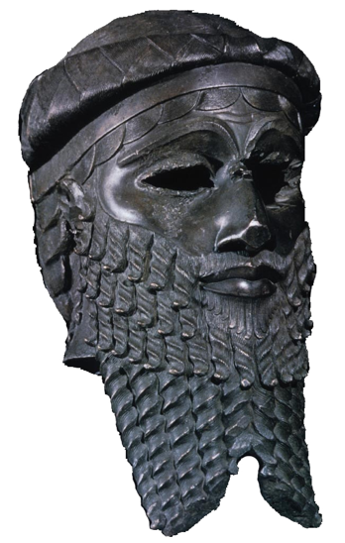
Cities, Kings, and Trade
Monarchy: Rule by a king or queen
The first king to unite several city-states under one rule was Sargon, around 2350 BCE
Installed governors and troops to secure his power

Slide 9
Cities, Kings, and Trade
Hammurabi: King of Babylon who is best known for his creation of a code of laws that explained what punishments should be given for specific crimes

Slide 10
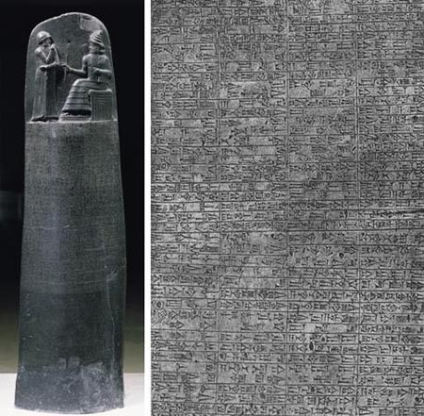
Hammurabi’s Code

Slide 11
Hammurabi’s Code
8. If any one steal cattle or sheep, or an ass, or a pig or a goat, if it belong to a god or to the court, the thief shall pay thirtyfold therefor; if they belonged to a freed man of the king he shall pay tenfold; if the thief has nothing with which to pay he shall be put to death.
15. If any one take a male or female slave of the court, or a male or female slave of a freed man, outside the city gates, he shall be put to death.
22. If any one is committing a robbery and is caught, then he shall be put to death.

Slide 12
Hammurabi’s Code
25. If fire break out in a house, and some one who comes to put it out cast his eye upon the property of the owner of the house, and take the property of the master of the house, he shall be thrown into that same fire.
110. If a "sister of a god" open a tavern, or enter a tavern to drink, then shall this woman be burned to death.
128. If a man take a woman to wife, but have no intercourse with her, this woman is no wife to him.
129. If a man's wife be surprised (in flagrante delicto) with another man, both shall be tied and thrown into the water, but the husband may pardon his wife and the king his slaves.

Slide 13
Hammurabi’s Code
138. If a man wishes to separate from his wife who has borne him no children, he shall give her the amount of her purchase money and the dowry which she brought from her father's house, and let her go.
145. If a man take a wife, and she bear him no children, and he intend to take another wife: if he take this second wife, and bring her into the house, this second wife shall not be allowed equality with his wife.
192. If a son of a paramour or a prostitute say to his adoptive father or mother: "You are not my father, or my mother," his tongue shall be cut off.

Slide 14
Hammurabi’s Code
195. If a son strike his father, his hands shall be hewn off.
196. If a man put out the eye of another man, his eye shall be put out.
197. If he break another man's bone, his bone shall be broken.
200. If a man knock out the teeth of his equal, his teeth shall be knocked out.
229 If a builder build a house for some one, and does not construct it properly, and the house which he built fall in and kill its owner, then that builder shall be put to death.
282. If a slave say to his master: "You are not my master," if they convict him his master shall cut off his ear.

Slide 15
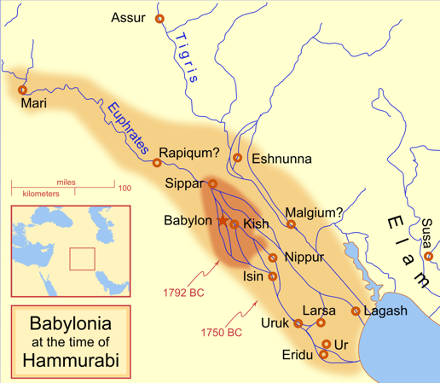
Cities, Kings, and Trade
In addition to his law code, Hammurabi was able to conquer a large amount of territory, known as the “Old Babylonian” State

Slide 16
Cities, Kings, and Trade
Long distance trade began during this era and included areas in the Middle East, Egypt, and the eastern Mediterranean
Merchants gained more influence over time as they exchanged surplus goods
This could include raw materials or luxury goods
Items were bartered, traded for one another, or valued in relation to fixed weights of precious metals (usually silver) or grain

Slide 17
Mesopotamian Society
The rise of urban areas meant the creation of social divisions that divided people
Some groups were able to attain vast wealth and large agricultural estates
Typically these were temple leaders or kings
The people at the bottom of the social ladder were punished more harshly for their crimes

Slide 18
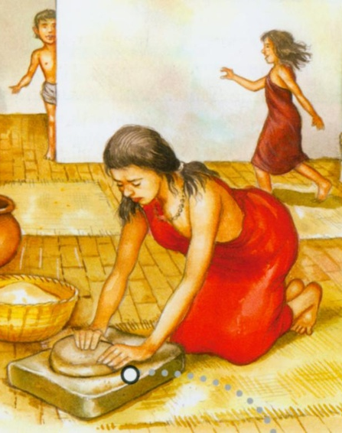
Mesopotamian Society
Food surpluses allowed from families to have more children
Women were prevented from acquiring the skills needed for specialized jobs due to this extra burden
However, women were allowed to own property, engage in trade, and control their dowry
Dowry: Money given by a brides father to support her in her husbands household

Slide 19
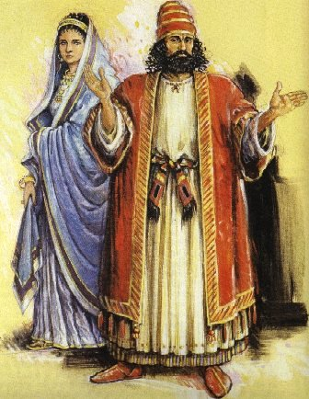
Mesopotamian Society
Marriage alliances made women into instruments for preserving and increasing family wealth
Constraints on women's lives meant that they were expected to remain in the home and wear veils in public

Slide 20
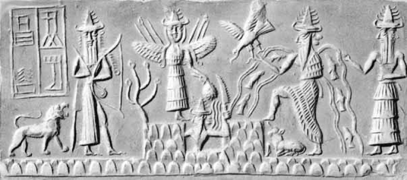
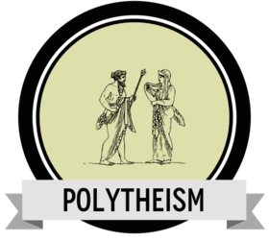
Gods, Priests, and Temples
Polytheism: The belief in many gods or goddesses
Sumerian gods embodied the forces of nature
These gods were anthropomorphized, meaning that they were given human characteristics
In The Lion King the animals are anthropomorphized because they are able to speak and express emotions
These gods were seen as responsible for any natural disasters that affected the people of Mesopotamia
Therefore, sacrifices had to be made to appease them

Slide 21
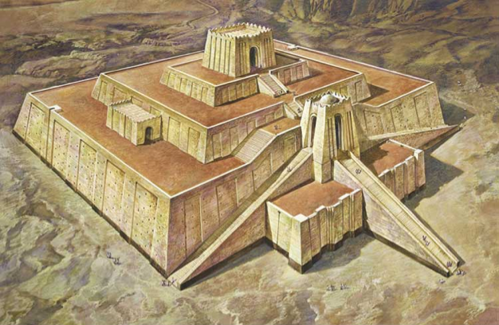
Gods, Priests, and Temples
Ziggurat: A massive, pyramidal stepped tower made of mud bricks and associated with unknown religious meaning

Slide 22
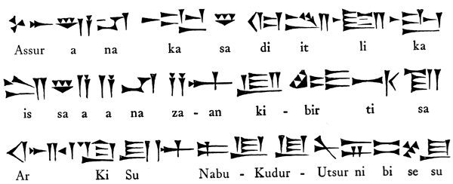
Technology and Science
Writing first appeared in Mesopotamia around 3300 BCE and originated as a system of record keeping
As business transactions became more common and wealth grew, it became essential to keep track of facts and figures
Cuneiform: Mesopotamian writing system in which wedge shaped symbols represented words or syllables

Slide 23
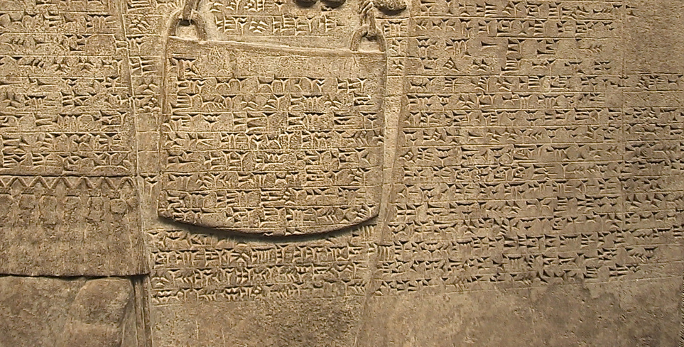
Cuneiform

Slide 24
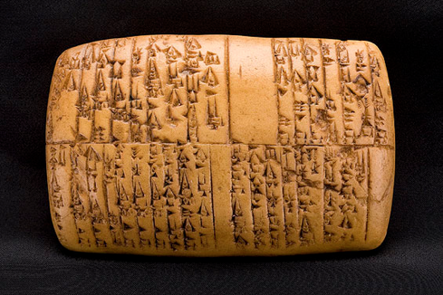
Technology and Science
Cuneiform - Not a language, only a writing system
Only the elites and scribes could master it
Originally used for economic reasons, eventually used to write about politics, religion, and science

Slide 25
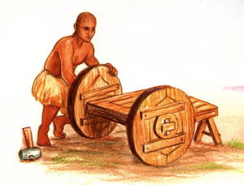
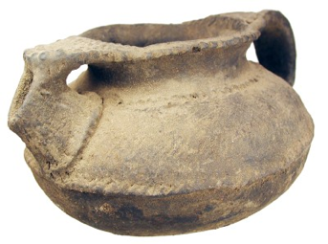
Technology and Science
Other technological advances in Mesopotamia include wheeled carts and boats
Metals had to be imported but eventually copper and tin were made into an alloy known as bronze to produce tools and weapons
Clay was used to make dishware and storage vessels
Mud bricks were the primary building material

Slide 26
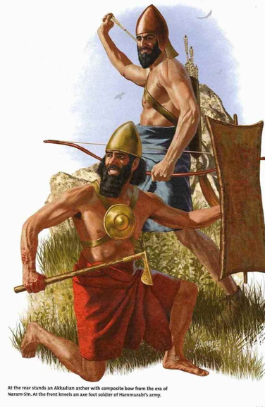
Technology and Science
Early military forces were militia, citizens who became soldier when it was necessary
Well-trained and well-paid full time soldiers came around during the 3rd and 2nd millenniums BCE

Slide 27
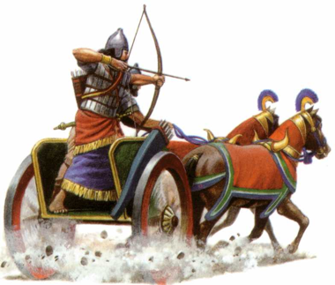
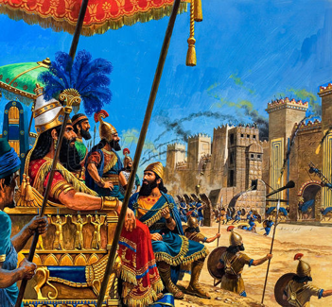
Technology and Science
Horse drawn chariots, which included a driver and an archer, revolutionized warfare as infantry could do little to defend themselves
Siege weaponry was created to climb over or knock down city walls

